Slide 1
OBSTACLE Avoiding Robot(Engelden Kaçan Robot )
PREPEARED BY:
Fatima Amiry

Slide 2
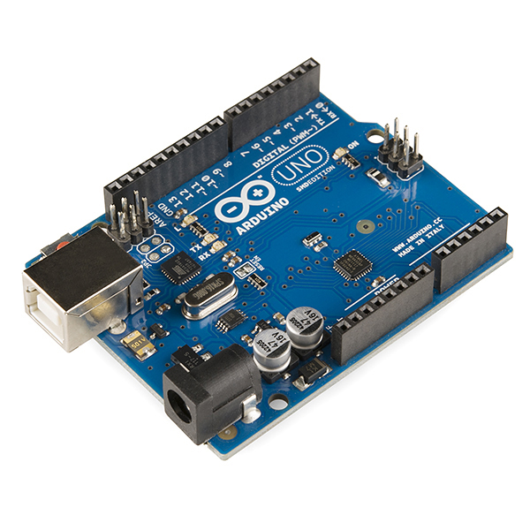
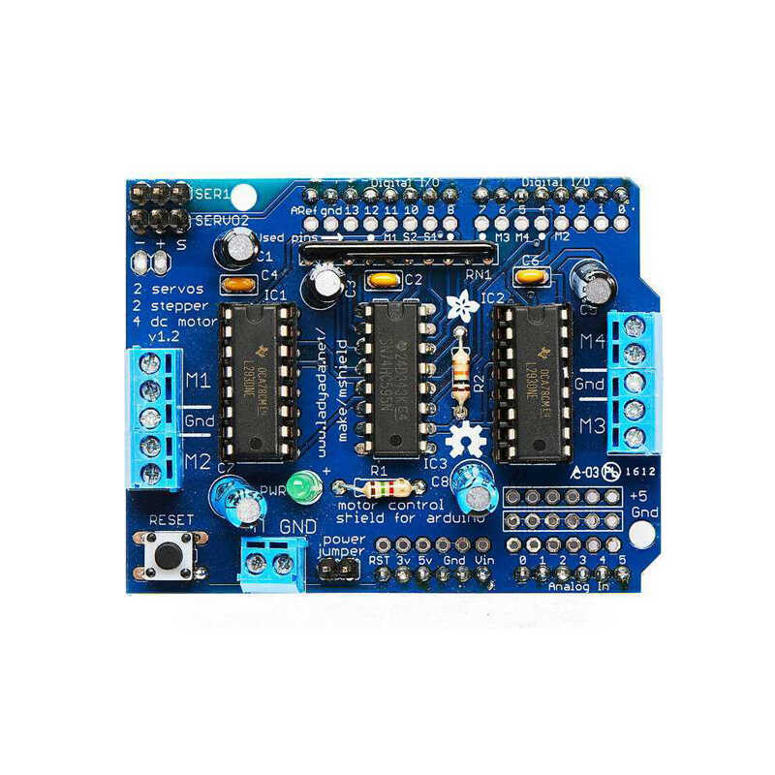
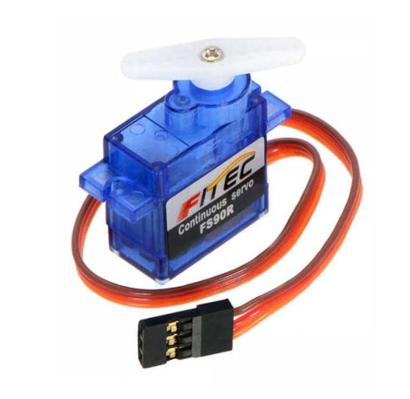
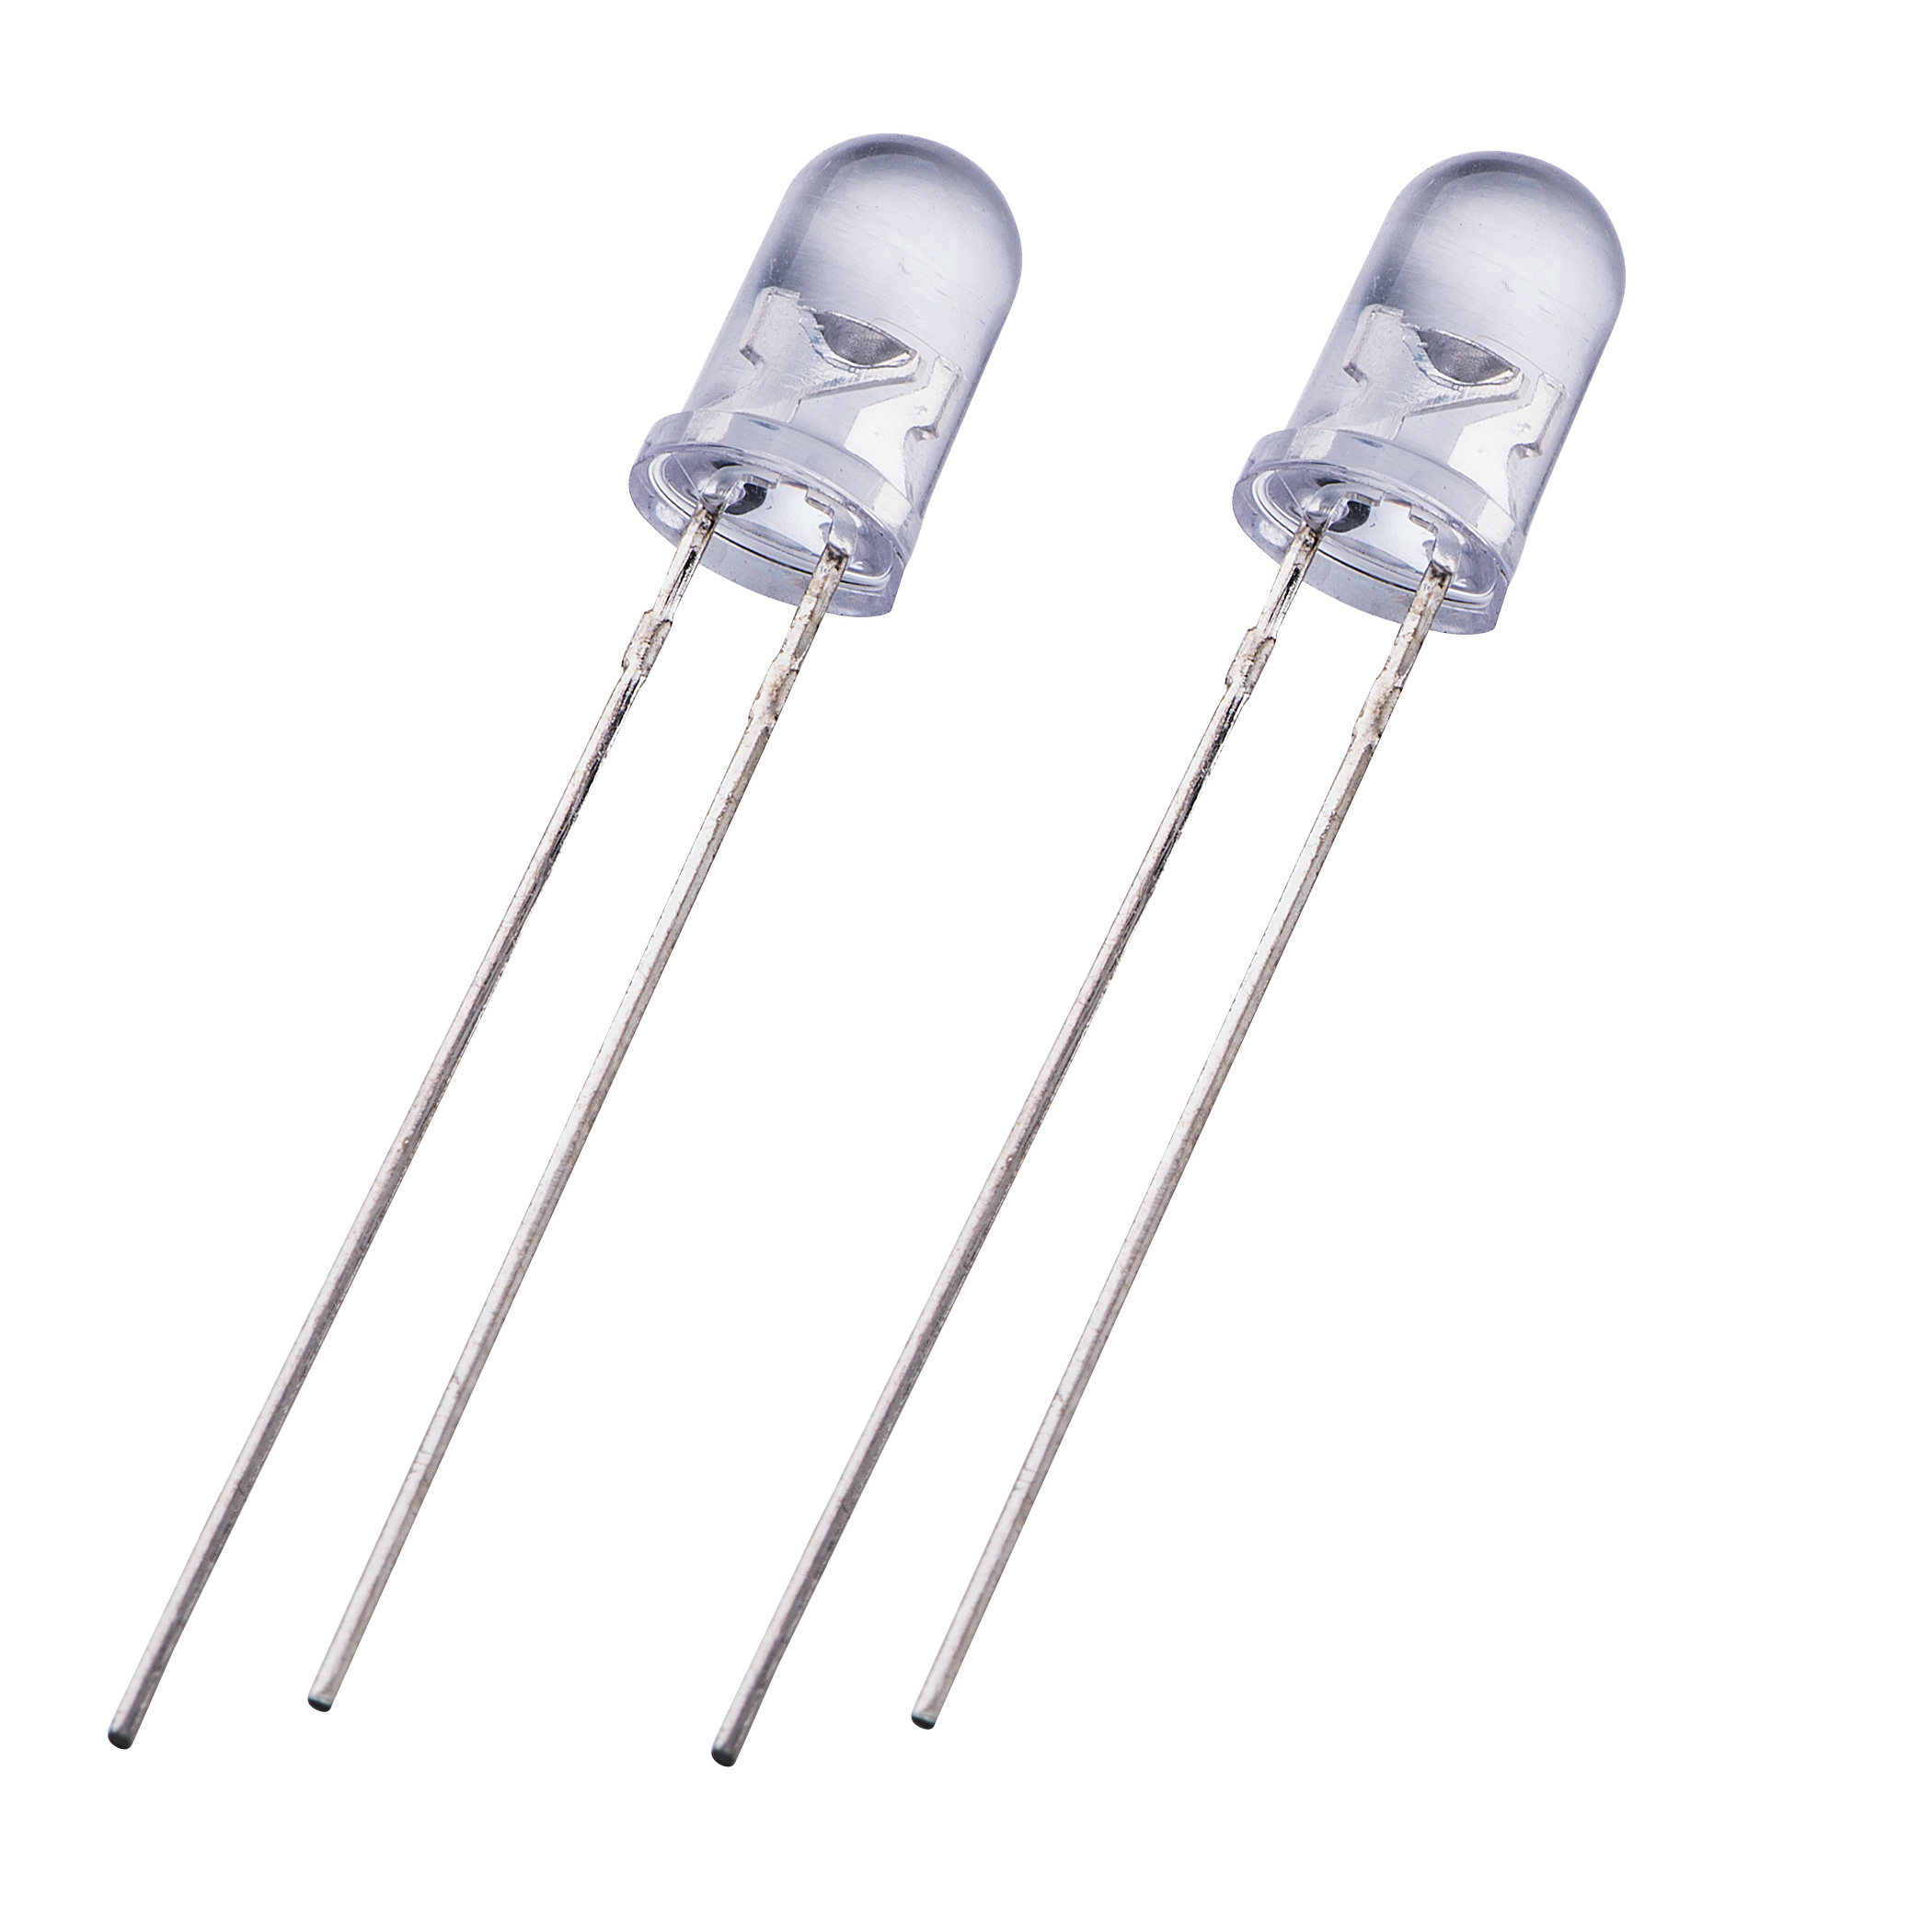
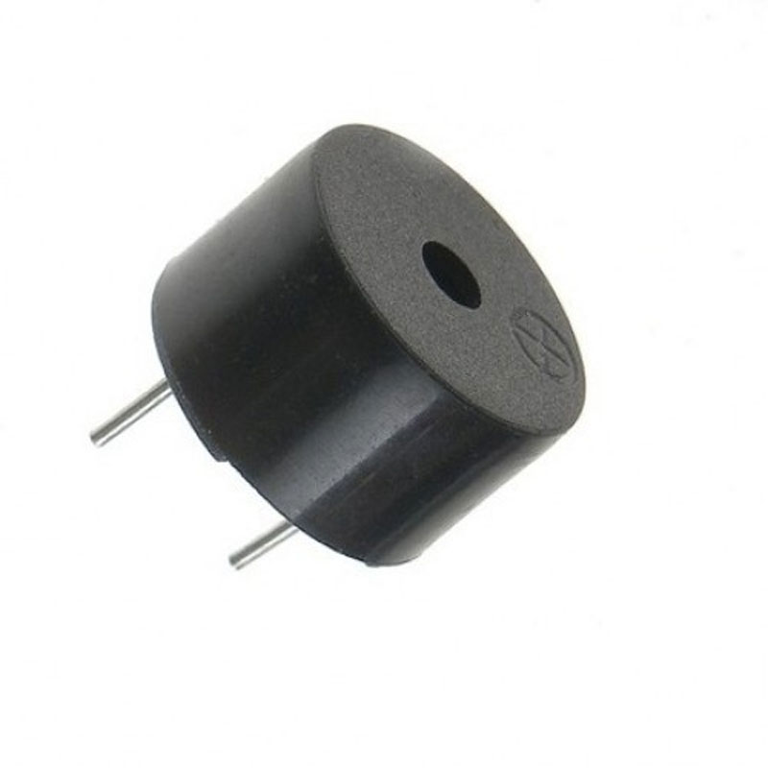
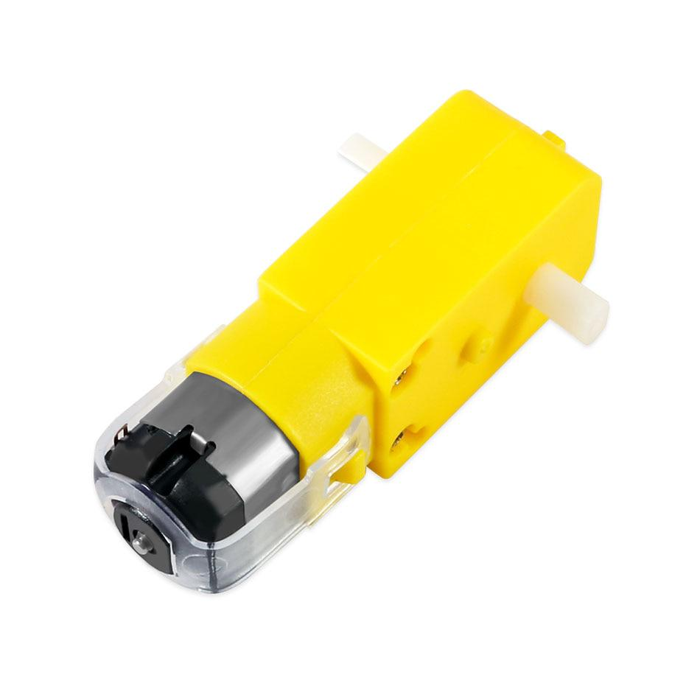
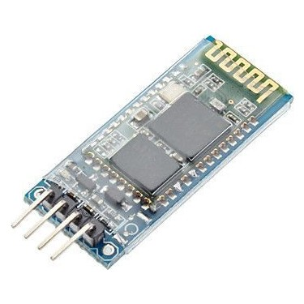
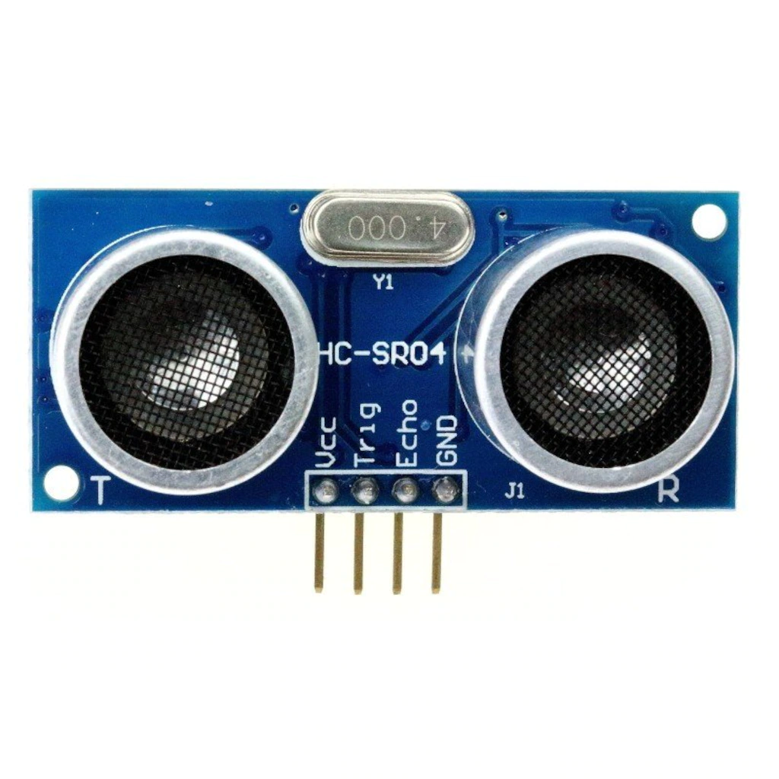
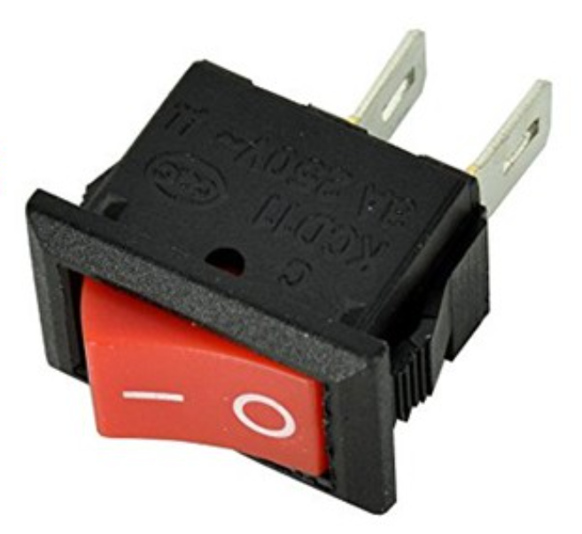
Kullandığımız Ekipmanları
LEDs
Arduino Uno
L293D Motor Shield
Servo Motor
Buzzer
Ultrasonic Sensor hc-sr04
HC-06
Bluetooth Module
DC gear Motor
Swich

Slide 3
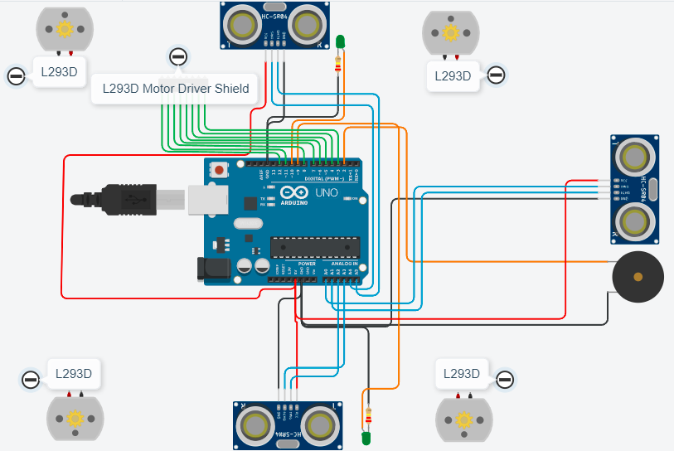
Structure

Slide 4
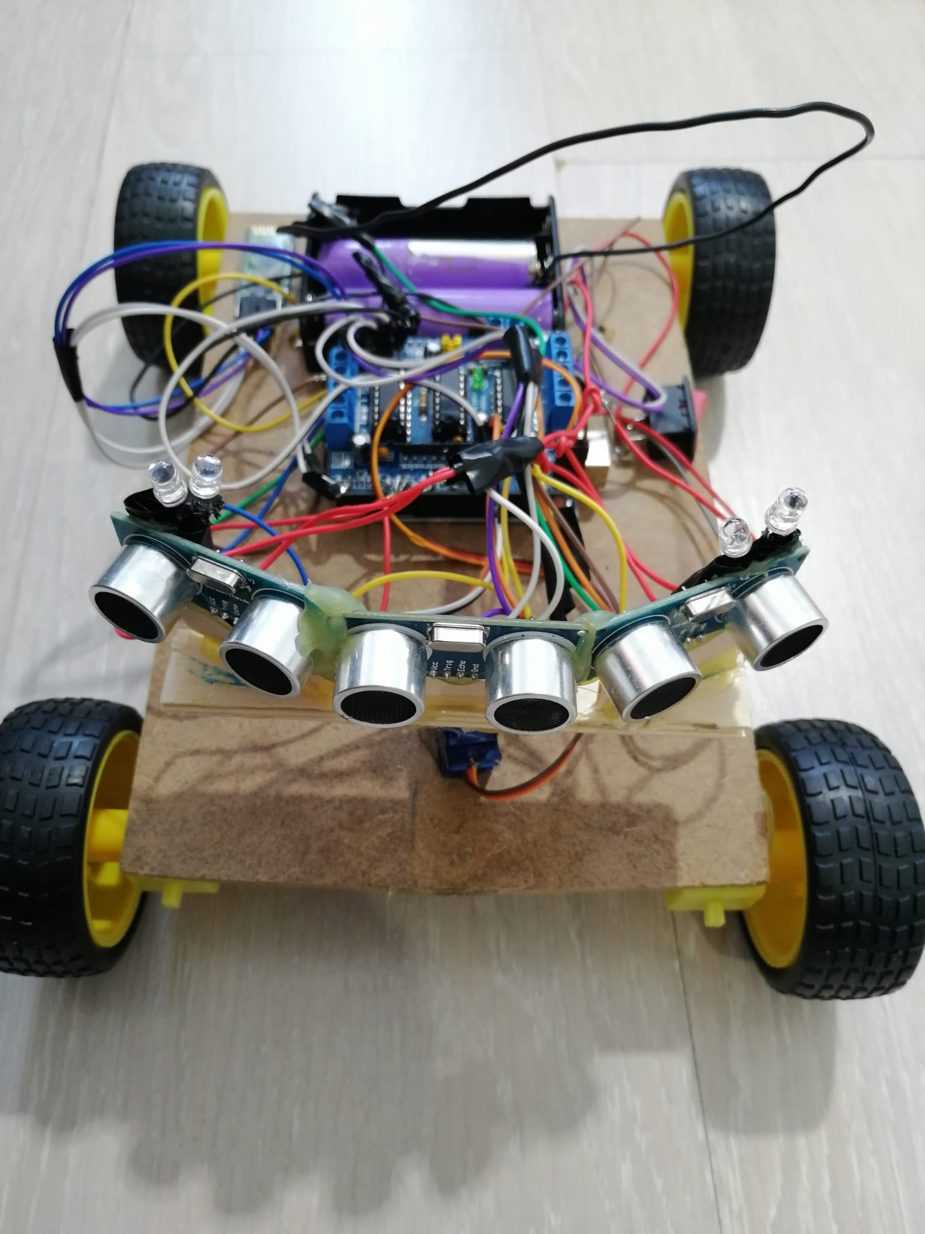
MAIN AIM
As seen in the diagram, we have four LEDs - two on the right and two on the left side. The ultrasonic sensors on both the right and left sides will scan for the nearest object around the vehicle. Simultaneously, the front sensor will continue measuring the distance. When an object gets close, the car will stop, emit an audible warning, and based on the distances on both sides, it will turn right or left. It will also turn towards the side with a farther object. The green LED on that side will light up, while the red LED on the other side will illuminate.

Slide 5
Robot Functions
"While the car is moving forward:
Read the value of the center sensor.
Read the value of the right sensor.
Read the value of the left sensor.
Continuously check if there is any nearby object in front of the car. If there is:
  Turn the buzzer on/off.
  Activate the LEDs.
  Turn the car right/left."

Slide 6
Setup Function...
start
define the DC motors
pins
Define motor's speed
define ULTRASONIC_front
trig A0
ech A1
define ULTRASONIC_right
trig A2
echo A3
define ULTRASONIC_left
trig A4
ech A5
define LED_right
PIN 9
define LED_left
PIN 10
end
"When the project starts, the setup() function is called. Variables and pin modes are defined, and libraries are initialized. The setup() function will run only once after each power-on or reset of the Arduino board.
For this project, we require 4 DC motors (2 pins per motor), and according to the L293D Motor Shield, we've used the following 8 pins: Pins 3, 4, 5, 6, 7, 8, 11, 12. As mentioned earlier, the L293D Motor Shield controls DC motors using 8 pins and also has the ability to control 2 servo motors by connecting their signal pins to pins 9 and 10. We'll use a single servo motor (Pin 10), so we've utilized Pin 9 as a regular digital output pin to control an LED.
Components:
DC Motors: Pins 3, 4, 5, 6, 7, 8, 11, 12
Servo Motor: Pin 10 (also used Pin 9 for an LED)
Buzzer: Pin 2
To measure the distance between the car and nearby obstacles, we need 3 ultrasonic sensors—one for the front (center), one for the right, and one for the left side. Arduino's official website specifies that the analog pins (A0-A5) can also be used as digital input/output pins. Therefore, we've used these pins for connecting the sensors. Remember that each sensor requires 2 pins for communication with Arduino (Trig pin triggers ultrasonic pulses, and Echo pin produces a pulse when the reflected signal is received. The length of the pulse is proportional to the time taken to detect the transmitted signal.)
Ultrasonic Front: A0 - A1
Ultrasonic Right: A2 - A3
Ultrasonic Left: A4 - A5"

Slide 7
loop()
the car moves forward
U_F <= 55
true
false
end
turn the buzzer on
U_R > U_L
true
false
car turns left by 90 derees
the car turns right by 90 degrees
turn the buzzer off
turn the buzzer off
end
end
U_F= measure ultrasonic_front distance
U_R=measure ultrasonic_right distance
U_L=measure ultrasonic_left distance
true
left RED LED ON
right GREEN LED ON
right RED LED off
left GREEN LEDoff
end
left RED LED off
right GREEN LED off
right RED LED ON
left GREEN LED ON
end
false
U_R > U_L

Slide 8
Resources
https://forum.arduino.cc/t/sending-data-from-one-arduino-to-another-via-bluetooth/372408- https://www.arduino.cc/
https://create.arduino.cc/projecthub/electropeak/arduino-l293d-motor-driver-shield-tutorial-c1ac9b
Photos
https://www.google.com/

Slide 9
Thanks!

